Slide 1
ENGINEERING DRAWING
Topic:
Line Types

Slide 2
Just as in English textbook the correct words are used for making correct sentences; in Engineering
Graphics, the details of various objects are drawn by different types of lines. Each line has a definite meaning and sense to convey.

Slide 3
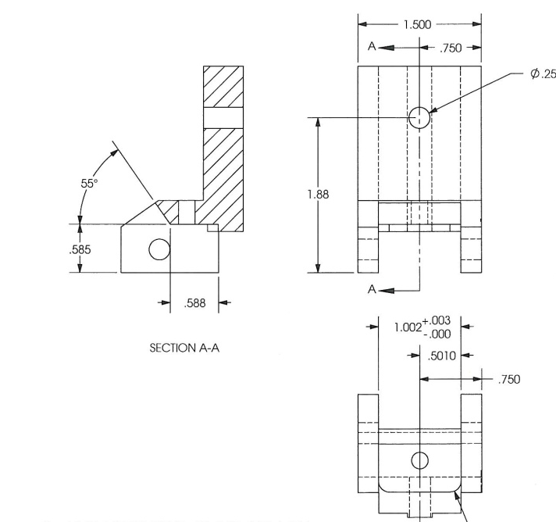
Introduction to Lines
LINES
Lines are like the alphabet of a drawing language. Each line in a drawing is used in a specific sense.

Slide 4
Introduction to Lines
Types of Lines
Lines differ from each other in two respects:
Their thickness or weight
eg:- Thick, medium & thin.
b) Their Shape or construction depending upon their conventional use.
Thick
Thin
Continuous
Dashed

Slide 5
Introduction to Lines
Thin Line- 0.1 mm Thick
Medium Lines- 1.5 x 0.1mm
Thick Line- 3 x 0.1 mm

Slide 6
Visible Outlines, Visible Edges: (Continuous wide lines) the lines drawn to represent the
visible outlines/ visible edges / surface boundary lines of objects should be outstanding in appearance.
Further slide shows continuous thick and thin lines

Slide 7
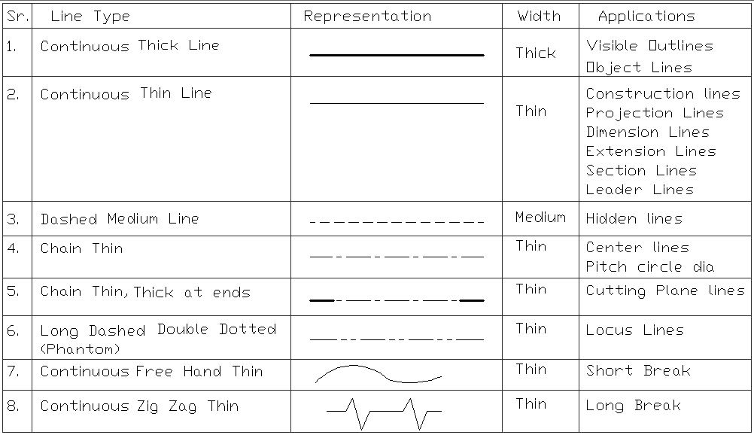
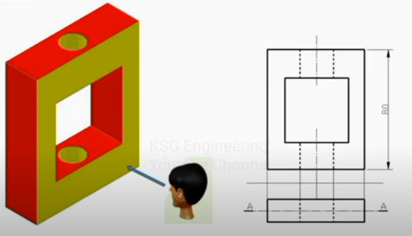
Type of Lines

Slide 8
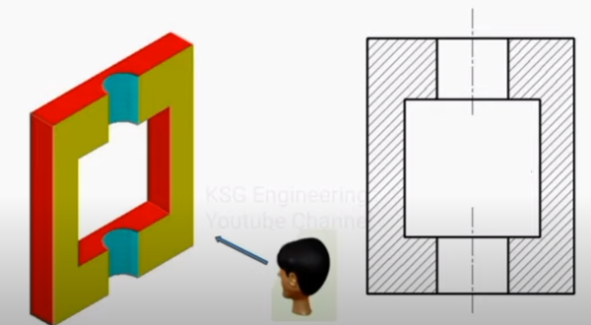
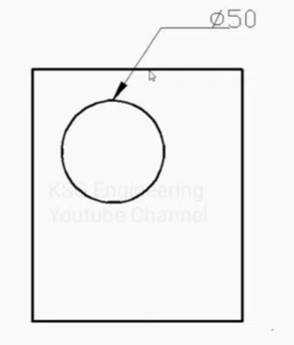
Type of Lines

Slide 9
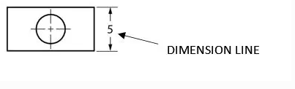
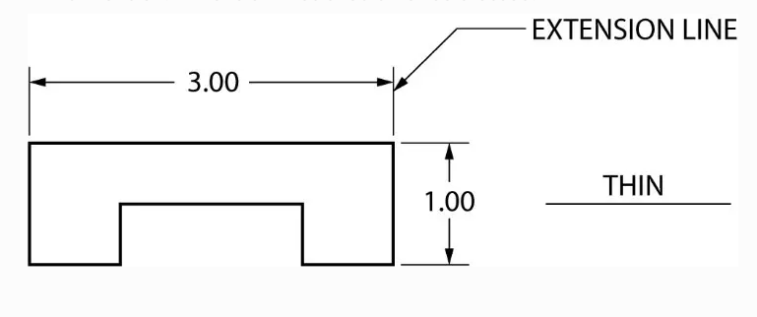
Dimension Lines (Continuous narrow Lines): Dimension Lines are drawn to mark dimension They represent length.
.
Extension Lines (Continuous narrow Lines): There are extended slightly beyond the respective dimension lines.
•
Construction Lines (Continuous narrow Lines): These are drawn for constructing drawings and should not be erased after completion of the drawing.

Slide 10
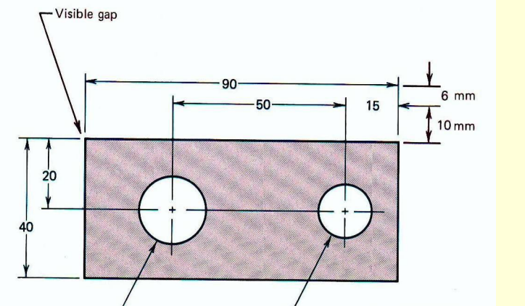
While drawing extension line There should be a visible gap of 1.5 mm between the feature’s corners and the end of the extension line. Dimension lines should not be crossed.

Slide 11
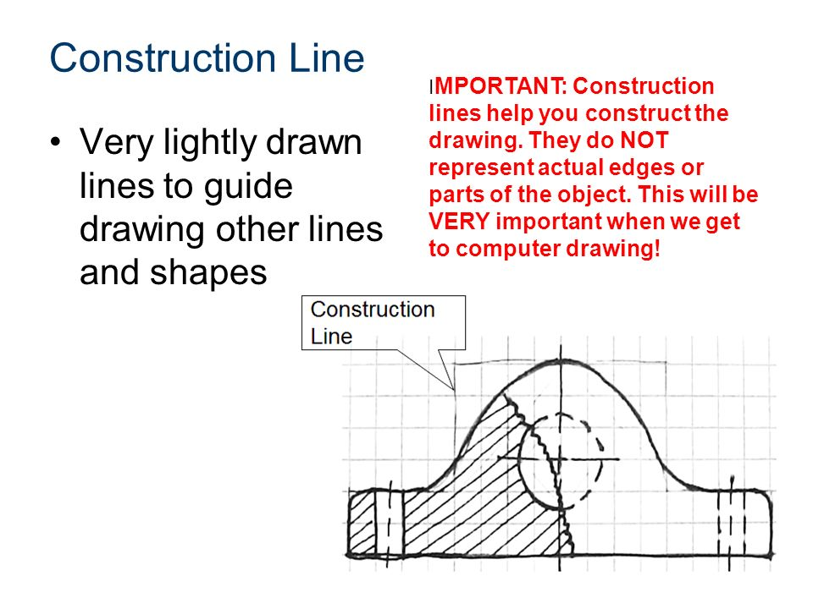

Slide 12
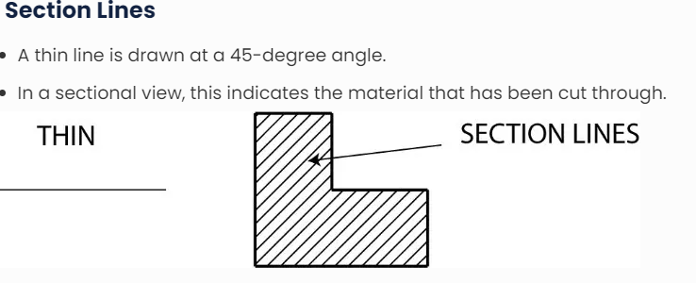

Slide 13
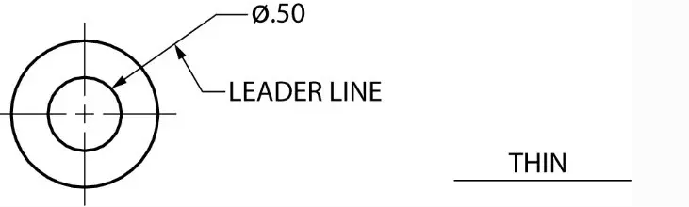
Leader Lines
Thin lines are used to connect a specific note to a feature on a drawing, as well as to direct dimensions, symbols, item numbers, and part numbers.
Typically drawn at 45, 30, and 60 degrees.
Has a short shoulder (3-6mm) at one end that begins at the center of the vertical height of the text and a standard dimension arrowhead at the other end that touches the feature.
Leader lines should not cross one another.
Leader lines should not be overly long.
Leader lines should not be vertical or horizontal in orientation.
Dimension lines, extension lines, and section lines should not be parallel to leader lines.

Slide 14
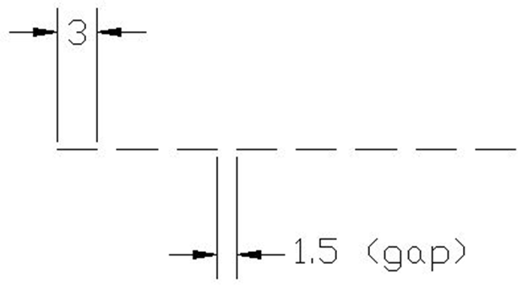

Type Of Lines

Slide 15
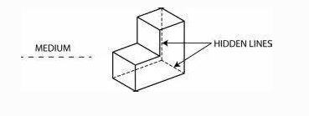
Hidden Lines
Lines that are light, narrow, short, and dashed.
Displays the outline of a feature that cannot be seen in a specific/particular view.
A dash should always be used to start and end hidden lines,.
Dashes should meet in the corners.

Slide 16

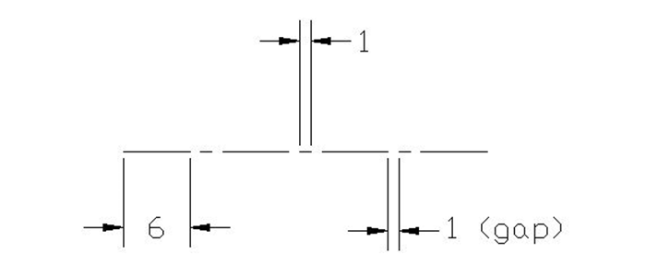
Type of Lines

Slide 17
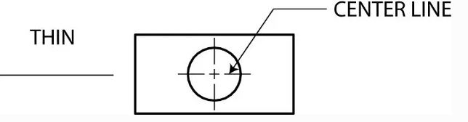
Center Lines
A thin line made up of alternating long and short dashes is used to show the center of round or cylindrical objects, as well as the symmetry of a feature.
Center lines should intersect by crossing either the long or short dashes and should continue a short distance beyond the object or feature.

Slide 18
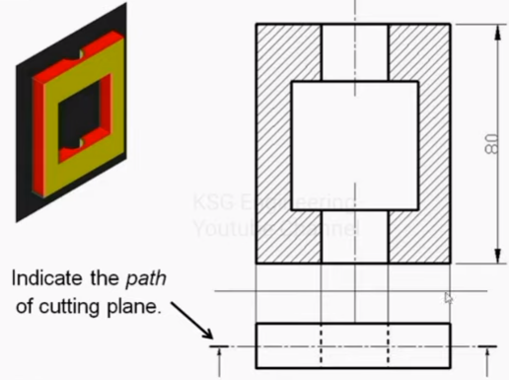
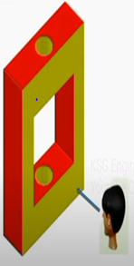
Type of Lines

Slide 19
Line Types

Slide 20
Line Types

Slide 21
Line Types

Slide 22
Meaning of Lines
Visible lines represent features that can be seen in the
current view
Hidden lines represent features that can not be seen in
the current view
Center line represents symmetry, path of motion, centers
of circles, axis of axisymmetrical parts
Dimension and Extension lines indicate the sizes and
location of features on a drawing

Slide 23
Thanks

